Slide 1
Data Driven Education
Natural Language Processing Sub team
Presentation 3

Slide 2
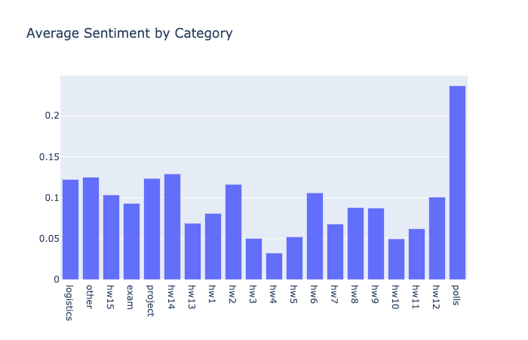
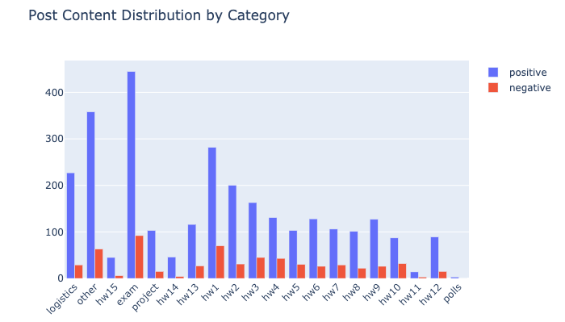
Phase 2 Conclusion : Jupyter Notebook
Visualizations with Plot.ly
Unlike Matplotlib, Plot.ly produces interactive and more user-friendly graphs with just a few lines of code
Plot.ly also integrates well with web development.
Therefore, we transformed our previous graphs produced by Matplotlib to the more visually appealing Plot.ly graphs

Slide 3
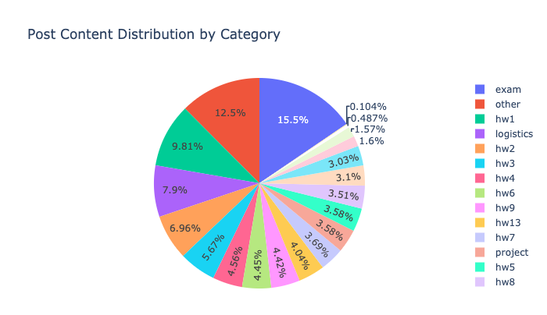
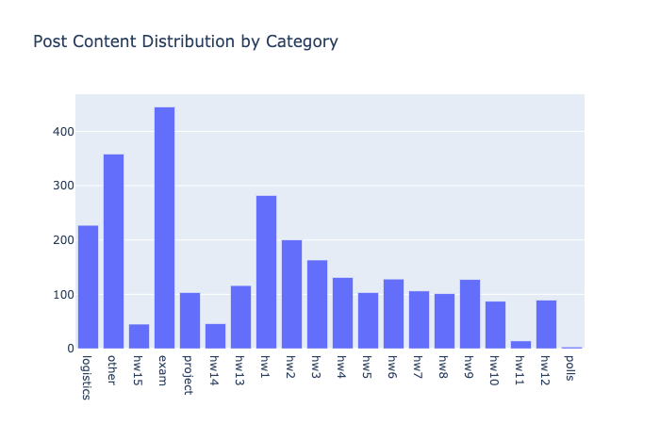
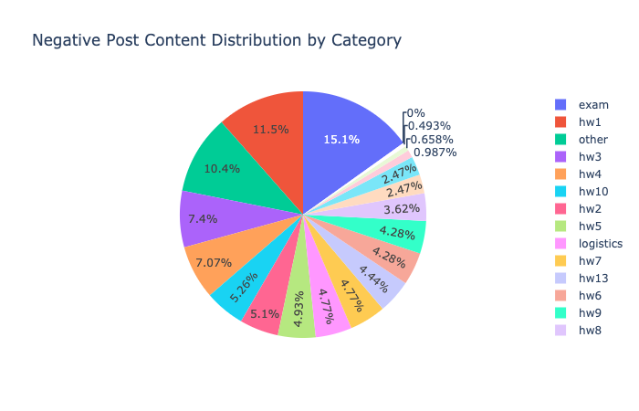
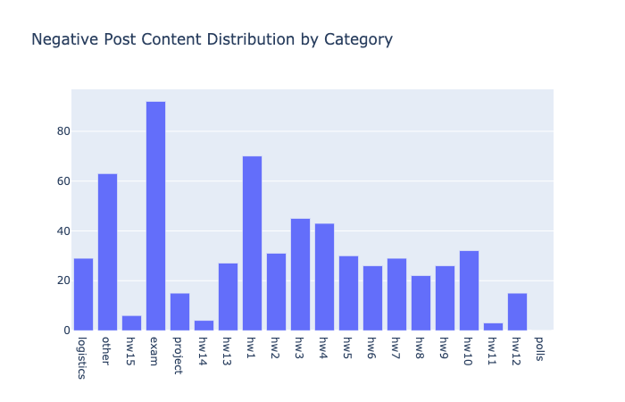
Jupyter Notebook - Visualizations with Plot.ly

Slide 4
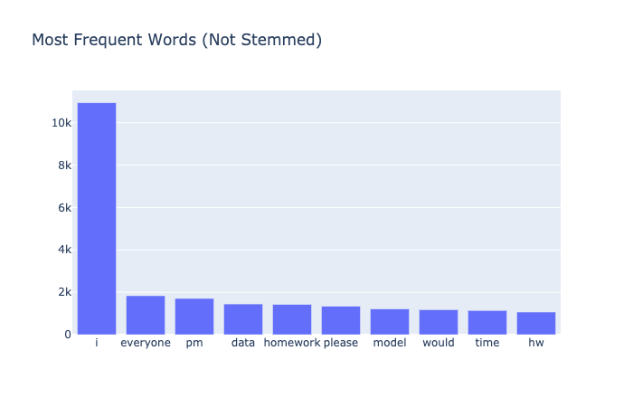
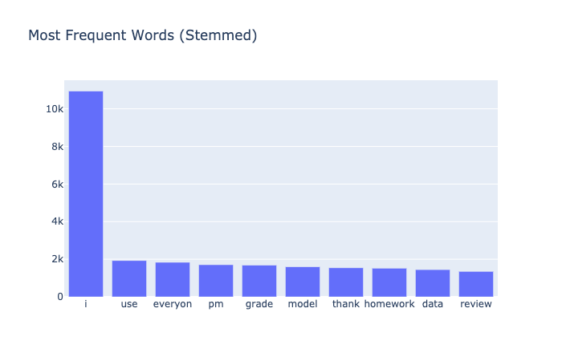
Jupyter Notebook - Visualizations with Plot.ly
Empowered by the NLTK package
Cleaned up the stopwords (‘the’, ‘is’, ‘are’, etc) from the post contents first
Performed tokenization and stemming on post contents
Below are the top 10 most frequent words

Slide 5
Phase 3: Building a Web App
Why?
We need more data
Collaborating with faculty and TA’s
Understanding the stakeholders needs in real environment
Agile and Scrum methodology

Slide 6
Phase 3: Building a Web App
How?
Using the Flask framework, credentials will be input by the user
The piazza scrape script will be run using the credentials and the results will be saved in MongoDB
The results will be run through the sentiment analysis
Sentiment Analysis will be visualized through Ploy.ly framework in the web app

Slide 7
October 11 - 25
October 25 - December 6
Working on an AdobeXD mockup of the web app design
Performing detailed research on Flask and Plot.ly
Web App Development with a minimum target of a Proof of Concept

Slide 8
Questions
Any suggestions for web app?

